Slide 1

Sprint #4 Presentation
Notes:
Alex

Slide 2


Sprint #4 Goals
Change our approach to the database being used
Continue to update main page (front end)
Continue looking for more recipes
Notes:
Dane

Slide 3
Updates
Business Requirement Document
No updates
Product Requirement Document
Updated Sprint Board, Gantt Chart, Burndown Chart, Project Tracker
Architecture and Design Document
No updates
User Stories
Released user stories this sprint
As a guest user, I want to be able to register for an account so that I can become an Account User and use the Account User’s features
As an account user, I want to be able to login to the system so that I can use the features of the system to accomplish what I need.
Notes:
Dane

Slide 4
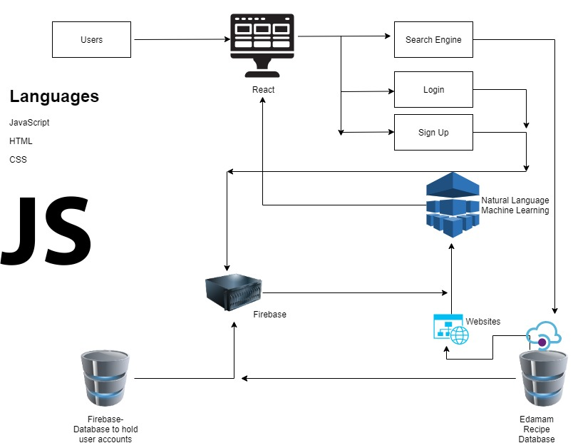


Architecture
React.js used for front-end
1 API - Edamam API
User Platforms:
Chrome Extension
Web application
ODM
Notes:
Alex

Slide 5
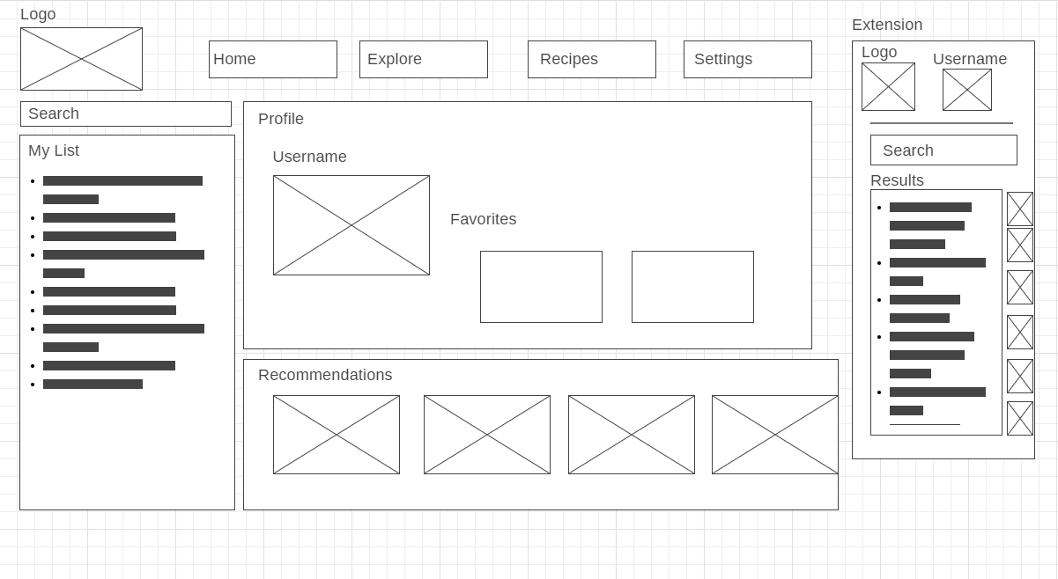
Wireframe
Notes:
Dane

Slide 6
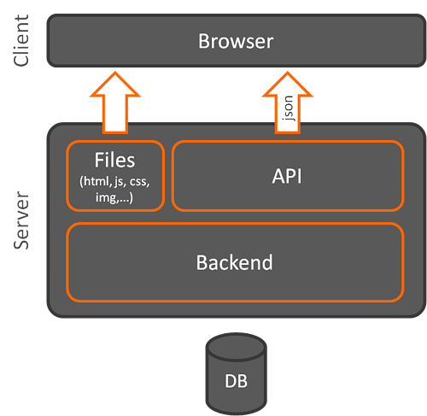
Client Side Architecture
Works in this general model:
Client devices send requests to the server
Server takes upon client requests
Fetch data from the server and returns as HTML
JSON if an API is used
Considerations:
Model-View-View-Model (MVVM)
Model-View-Controller (MVC)
Notes:
jose

Slide 7
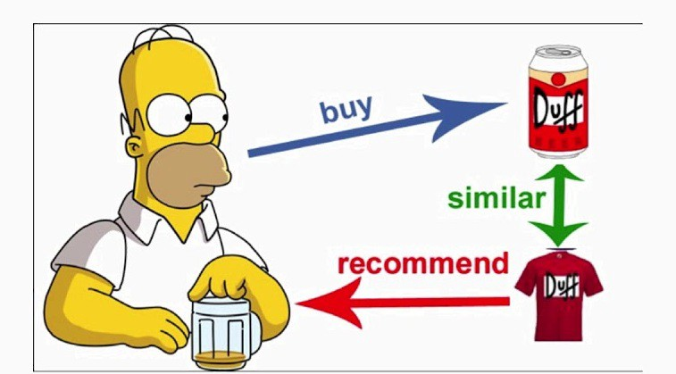
Recommendation Model - Machine Learning
What is it?
a subclass of information filtering system that seeks to predict the "rating" or "preference" a user would give to an item
How it is done?
Candidate generation, scoring, and re-ranking

Slide 8
Candidate Generation
The first stage of a recommendation model can have different approaches: Content-Based filtering and collaborative filtering
Content-Based Filtering: Uses similarity between items to recommend items similar to what the user likes
E.g If a user watches two cute dog videos, then the system will recommend cute animal videos
Collaborative Filtering: Uses similarities between queries and items simultaneously to provide recommendations.
E.g If user A is similar to user B, and user B likes video 1, then the system can recommend video 1 to user A (even if user A hasn’t seen any videos similar to video 1)

Slide 9
Scoring
Training Data:
We are planning to test our system out by first doing simple selections that should result in the correct recommendations. Our data will be generated starting at a small scale and slowly increasing the scale
After candidate generation, another model will scores and ranks the generated candidates to select the set of items to display.
Examples of scoring criteria:
Related items from a matrix factorization model
User features that account for personalization
“local “ vs “distant” items; that is, taking geographic information into account
Popular or trending items
A social graph; this is, items liked or recommended by friends

Slide 10
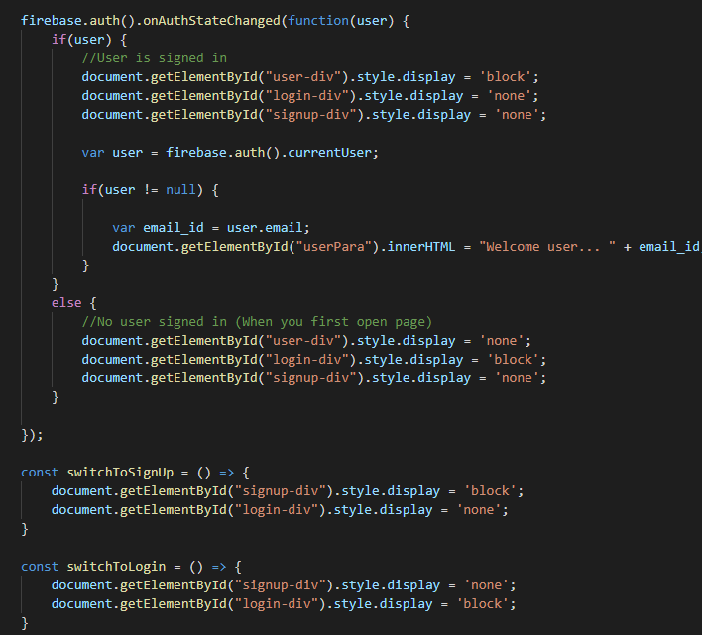
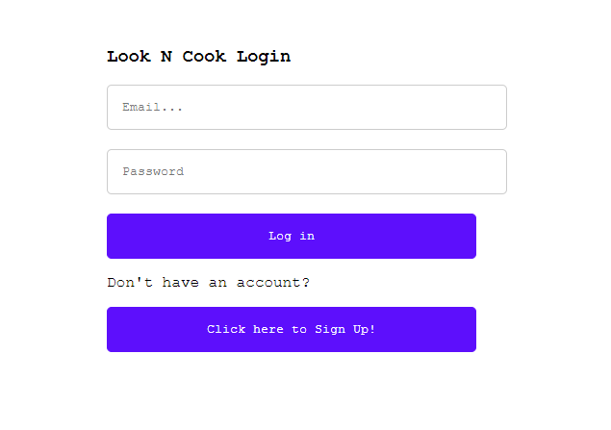
Front End (Before)
Notes:
john

Slide 11
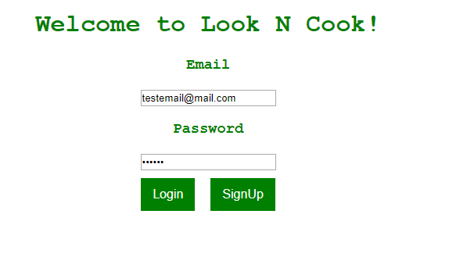
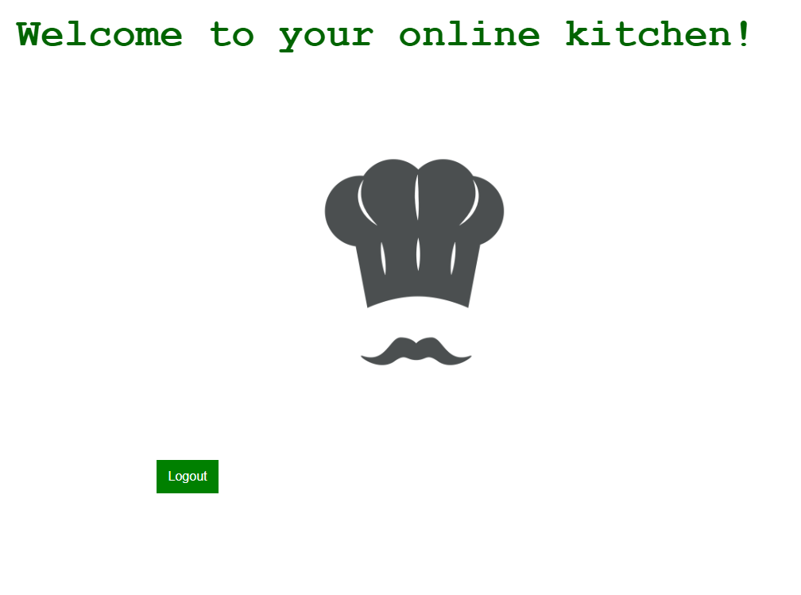
Front End (After)
Notes:
john

Slide 12
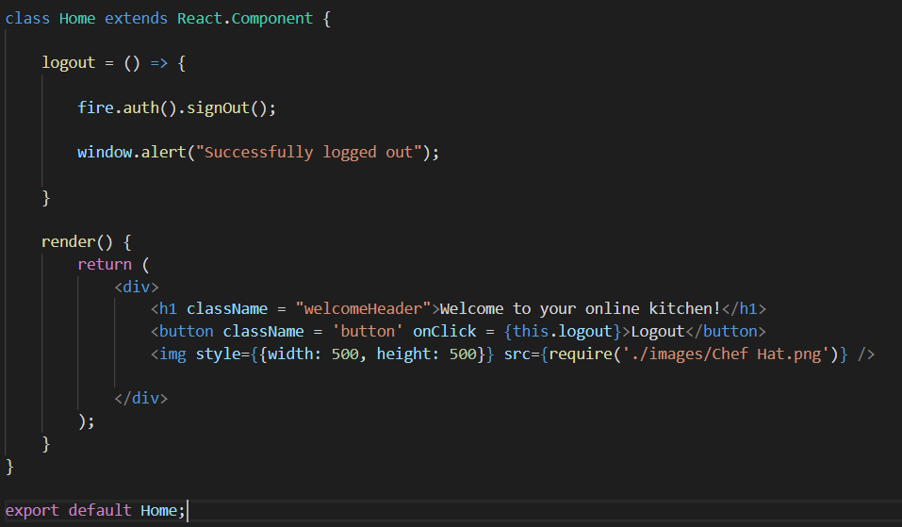
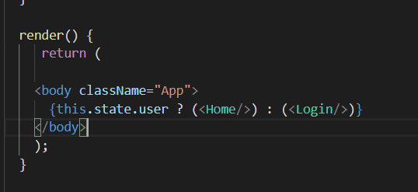
Changes
Notes:
John

Slide 13

Recipe Finder
Compile a list of cooking vocabulary to find the most common words
Use those words to distinguish between a recipe or a non-recipe
Notes:
alex

Slide 14
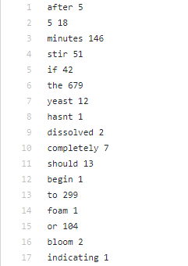
Recipe Finder
Gather words
Keep track of the recipes that we have already used to reduce redundancy
Record only 5 recipes of a certain food type for consistency
Using a program that reads a paragraph and splits them into individual words then adds them into a text file
Scoring system needs to be implemented
Some words are more important than other so there needs to be categorized in a tier list
https://www.d.umn.edu/~alphanu/cookery/glossary_cooking.html
Recipe instruction tend to be in one section
Notes:
https://www.d.umn.edu/~alphanu/cookery/glossary_cooking.html

Slide 15
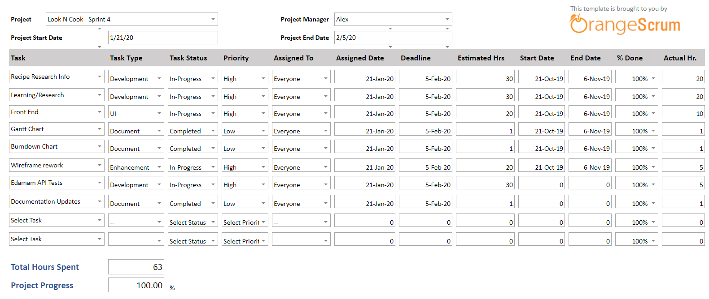
Project Tracker
Notes:
Dane

Slide 16
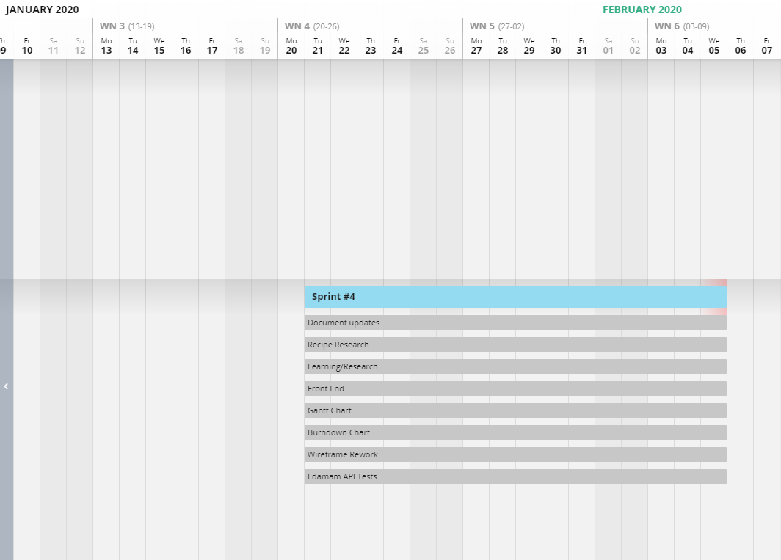
Gantt Chart
Notes:
henry

Slide 17
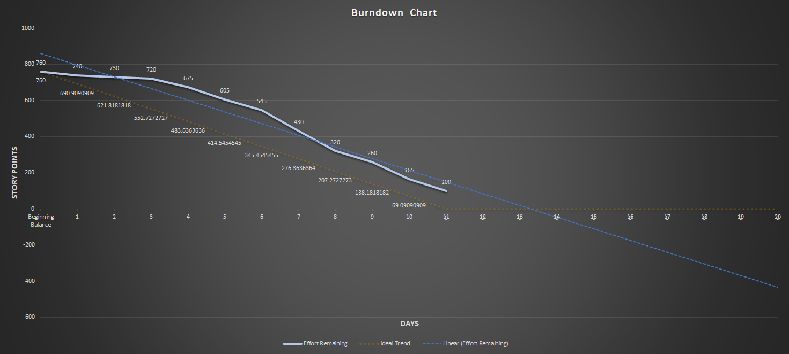
Burndown Curve
Notes:
Jose

Slide 18
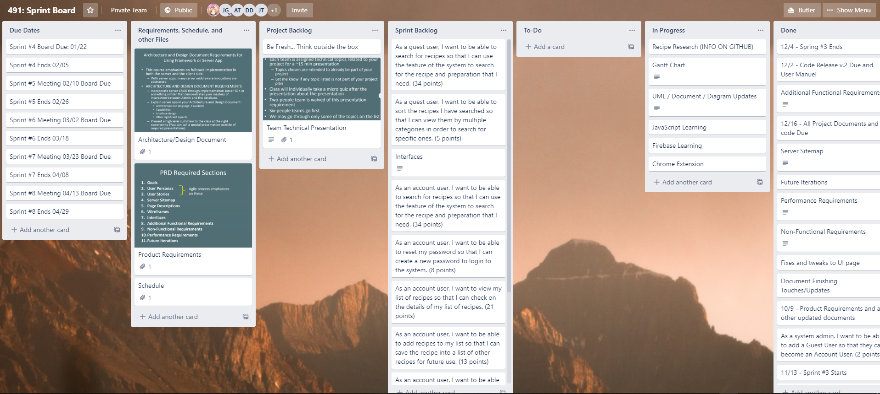
Sprint Board-Before
Notes:
henry

Slide 19
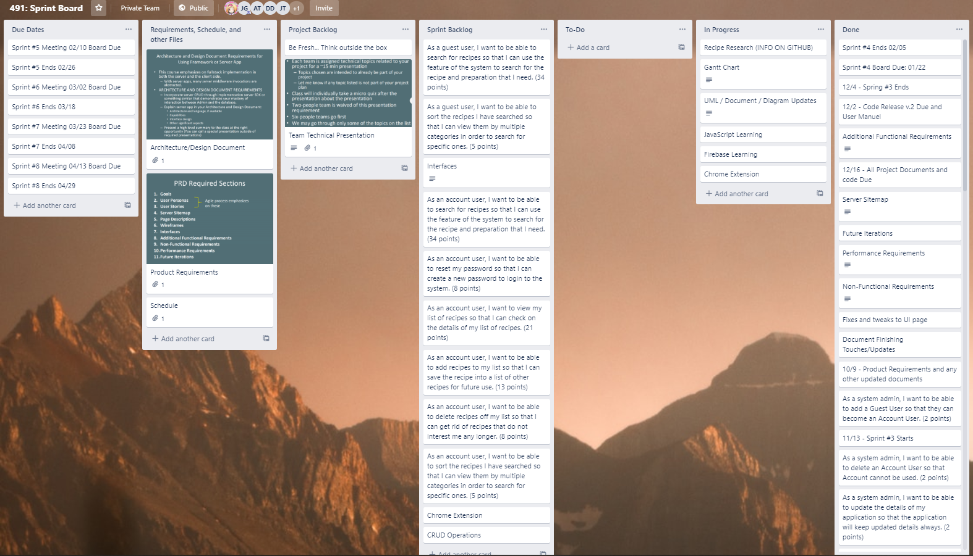
Sprint Board-After
Notes:
henry

Slide 20
Sprint Retrospective
Did we meet our Sprint Goal?
Yes, we met our sprint goal well, as our sprint goal was to work more on the front end and database
What worked well/Didn’t work well?
We were able to get some good feedback regarding recipe researching
More confident in how we will be handling the database
What caused problems?
Time needed - complications of how our group wanted to handle the database took up a lot of time
How to improve for next sprint/Conclusions
Decision on database changes took up time
Need to increase time put into the application
User story points planned: 30
User story points achieved: 30
User stories in progress: 4
Notes:
Dane

Slide 21

Plans for the next sprint
Working with the Edamam API to get our out database set up with recipes
Learn web parsing and chrome extensions
Continue working on the recipe finder. Finishing it earlier is best
Notes:
alex

Slide 22
Code Demo
https://look-n-cook.firebaseapp.com/
Notes:
John
Full URL
https://github.com/JohnO135/491SeniorProject/blob/master/Documents/User%20Manual%20v1.1.pdf

